Slide 1
CSE 3100: Systems Programming
Part 3
Lecture 1: An Introduction to Threads
Professor Kaleel Mahmood
Department of Computer Science and Engineering
University of Connecticut

Slide 2
Administrative Announcements
There will be one homework on forks/pipes assigned this week.
Exam 2 will be Friday March 29th in lab.
Exam 2 will only cover PART 2 lecture material.
Next week we will do review for exam 2.

Slide 3
Review from last lecture: Using pipes with the fork() function
The “cat” executable gives us text output.
The “tr” executable translates text.
What we want our code to do:
Have a parent create two children (A and B).
Child A creates some text and writes it to the pipe using “cat” executable.
Child B reads from the pipe and uses the “tr” executable to convert the text to capital letters.

Slide 4
High Level Strategy for Pipe Setup
High-level strategy (missing clean up !)
Assume we want to launch two executables using two children.
Create a pipe
Fork #1
In child process
Redirect stdout to the write end of the pipe
Start A, by calling exec
Fork #2
In child process
Redirect stdin to the read end of the pipe
Start B, by calling exec

Slide 5
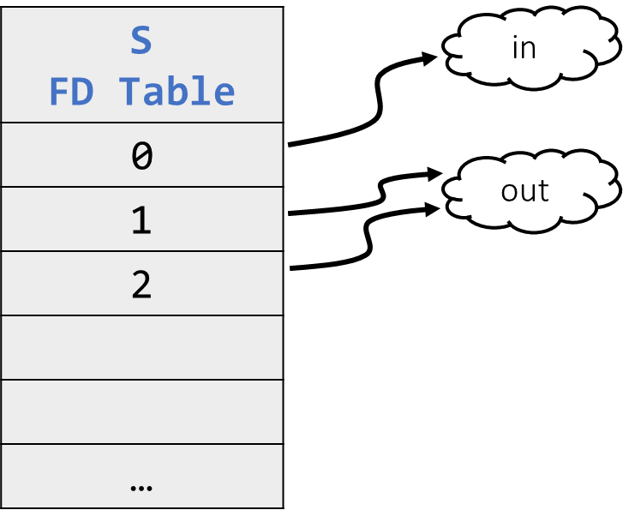
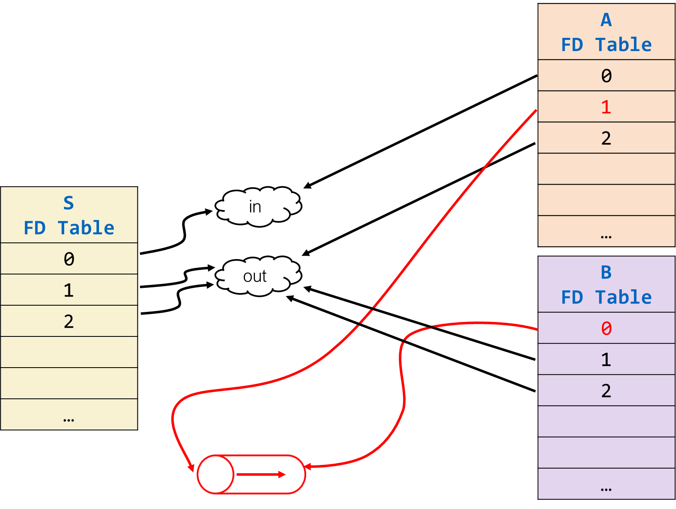
Why was this problem tricky?
The majority of the tasks involved setting up pipes between the parents and the children.
The parent and child have independent copies of memory due to the fork() call.
What if there was another way to do things in parallel?

Slide 6

Part 3: Threading in C

Slide 7
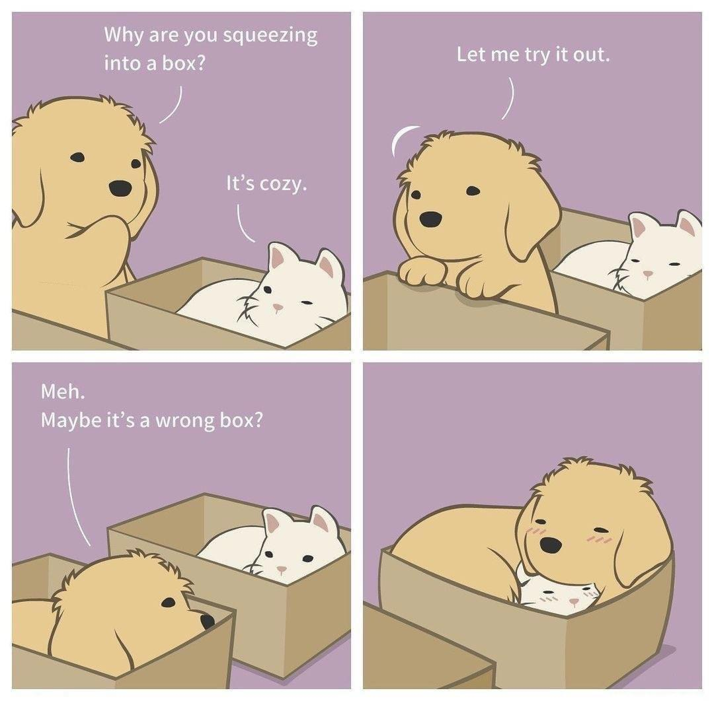

A basic diagram to understand threading vs fork:
Using Fork
Call to Fork:
Now we need two pipes to talk to each other.
Process #1
Process #2
Process #2
Process #1

Slide 8
A basic diagram to understand threading vs fork:
Using Threads
Thread #1
Thread #2

Slide 9
Basic Idea of Threads
Tasks need to run in parallel and SHARE the same memory space.
Don’t want the hassle of setting up pipes.
Each task you want to run is done by creating a new thread.
What are the difficulties?
-Threads need to be told when to terminate.
-The main process should wait for the threads to finish.
-C threading syntax is obtuse (Professor Kaleel’s opinion)
Let’s go back to our sorting problem and redo it using threads…

Slide 10
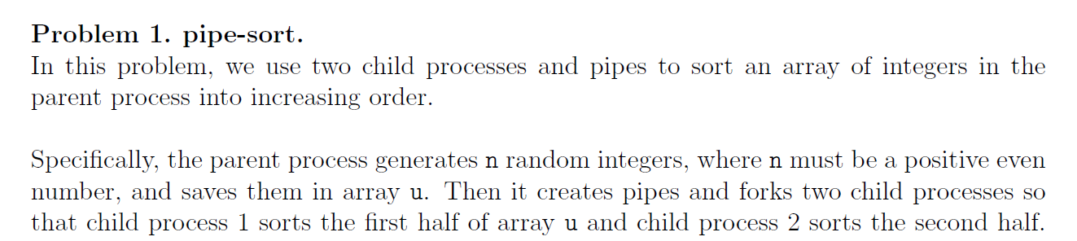
Threading Coding Example:
we have
First thread
second thread

Slide 11
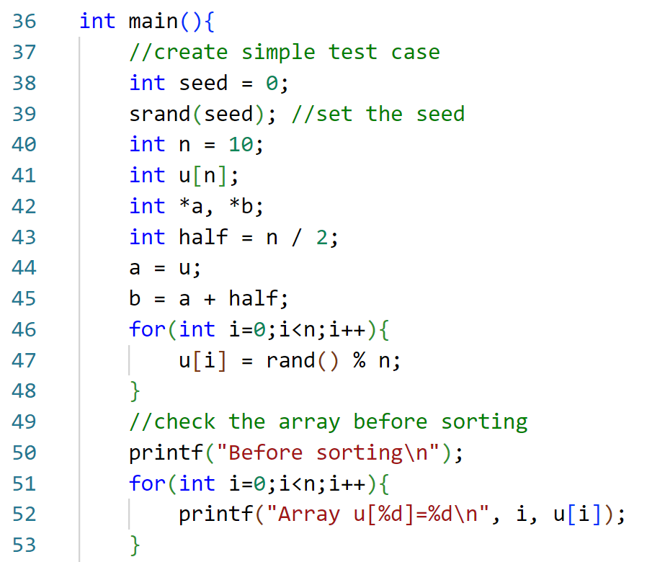
Recall: Basic Parts of the Parallel Sorting Code
Create the array u with random integers.
Have a pointer to the start of the array called a.
Have a pointer to the middle of the array called b.

Slide 12
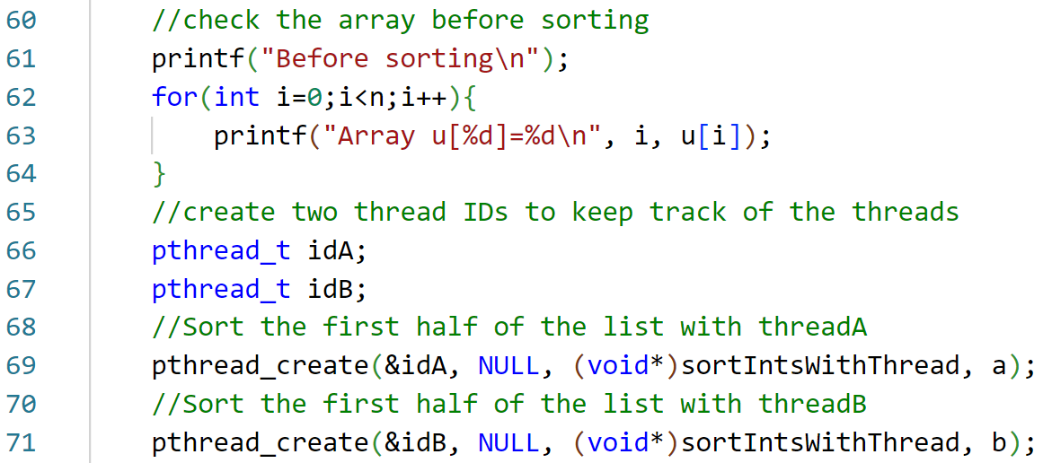
Parallel Sorting with Threading
Create two threads and have them run the function sortedIntsWithThread

Slide 13
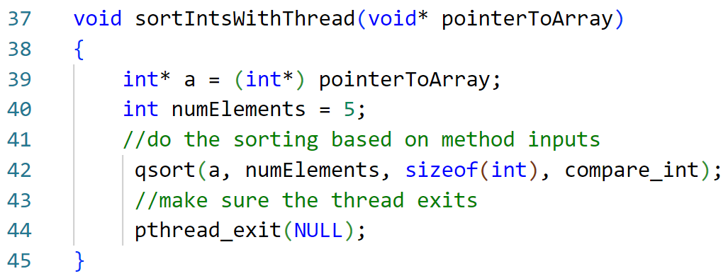
Who is sorted IntsWithThread? (1)
The function takes in a generic void pointer.
In this case we need it to point to the array we are sorting.

Slide 14
Who is sorted IntsWithThread? (2)
Typecast the pointer to be an integer pointer to actually use it.

Slide 15
Who is sorted IntsWithThread? (3)
Hardcoded how many elements we want to sort.
Is this good coding practice?

Slide 16
Who is sorted IntsWithThread? (4)
This is a new function.
When we call a function in the thread we need to specify when the thread should terminate.

Slide 17
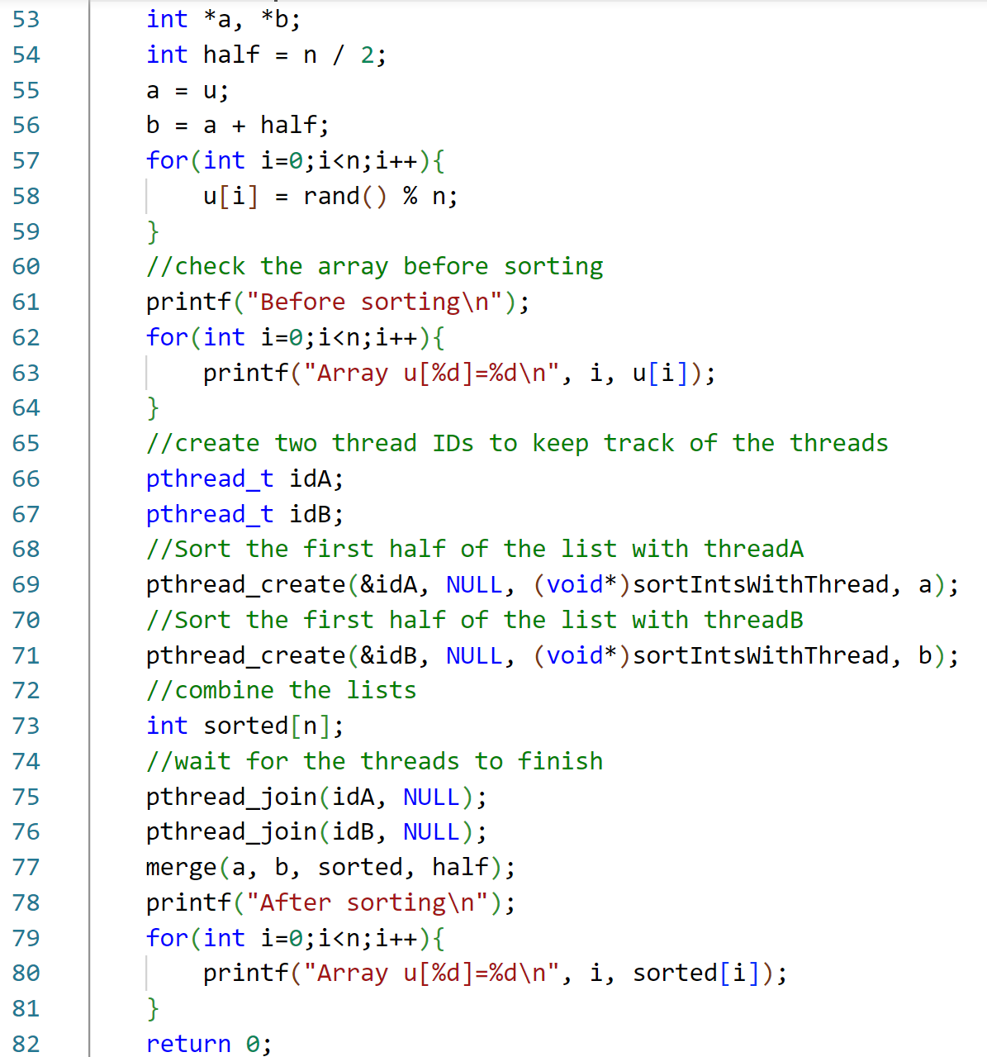
Big Picture
Create the array and fill in with random values.

Slide 18
Big Picture
Print the array before sorting

Slide 19
Big Picture
Create two thread IDs so we can keep track of the threads and check when they finish.

Slide 20
Big Picture
Create two threads to do the sorting.
Note we created a special sorting function that takes in a void pointer.
The special sorting function also calls the exit thread function.

Slide 21
Big Picture
The last argument passed in pthread_create is given to our special function.
The special sorting function also should call the exit thread function.

Slide 22
Big Picture
Wait for the threads to finish using the pthread_join function.
Once both threads are done then call the merge function to merge the two sorted parts.

Slide 23

Big Picture
Print the results and we’re done.

Slide 24
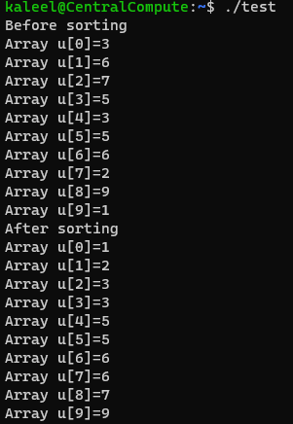
Sample Output

Slide 25
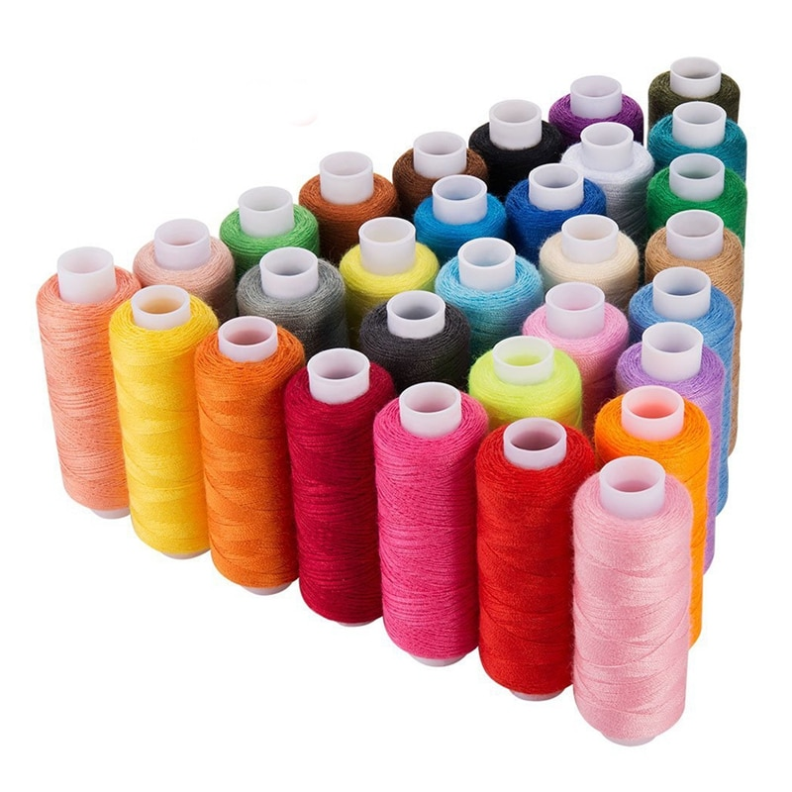
Summary: How did we convert to parallel processing with threads?
We need a special function that takes ONE void pointer as input.
The special function should call the thread exit function at the end.
In main we need to call the create thread IDs.
We need to call the thread create function.
In main we need to use the thread join function to wait for the threads to finish.

Slide 26
Formal Threading Definitions

Slide 27
Process and Thread Definitions
Process is a bundle grouping
A virtual address space [memory]
A collection of files [IO]
A collection of concurrent threads [execution units]
Thread is a light-weight entity
Can run concurrently with other threads
Share resources in the process [having same rights]
Confined to a single process [cannot “move” to another]
Can be created and destroyed [different life cycles]
Light-weight 'processes' that share the address space (and other resources) in a process.

Slide 28
Thread Creation and Destruction
How is a thread created?
By another thread! pthread_create()
It is given a stack to execute and a function to run
What about the first thread?
When a process is created, there is a single thread [starts alone]
How does a thread die?
Voluntarily, after completing its task
pthread_exit()
Requested by another thread
pthread_cancel()
When the process dies (along with all threads in it)
Any thread calls exit()
Note that exit() is called when main() returns !

Slide 29
Thread Syntax : Creation 1
We need the threading library: # include <pthread.h>
We need to create a thread ID:
Then call pthread_create: pthread_t id;
int pthread_create(pthread_t* thread, pthread_attr_t* attr, void* (*start_routine)(void*),void* arg);
Returns 0 if successful, and non-zero (> 0) if error.

Slide 30
Thread Syntax : Creation 2
int pthread_create(pthread_t* thread, pthread_attr_t* attr, void* (*start_routine)(void*),void* arg);
Id for the thread that is being created.

Slide 31
Thread Syntax : Creation 3
int pthread_create(pthread_t* thread, pthread_attr_t* attr, void* (*start_routine)(void*),void* arg);
attr specifies the attribute for the thread. NULL for default.
Can modify the size of the stack memory the thread is given or how the thread should be scheduled.
Source: https://www.educative.io/answers/how-to-create-a-simple-thread-in-c

Slide 32
Thread Syntax : Creation 4
int pthread_create(pthread_t* thread, pthread_attr_t* attr, void* (*start_routine)(void*),void* arg);
start_routine() is the function the thread will run.
Note the function can only take in ONE argument which is a void type pointer.

Slide 33
Thread Syntax : Creation 4
int pthread_create(pthread_t* thread, pthread_attr_t* attr, void* (*start_routine)(void*),void* arg);
void * arg is passed to start_routine()
Basically the argument to the function that the thread is going to run.

Slide 34
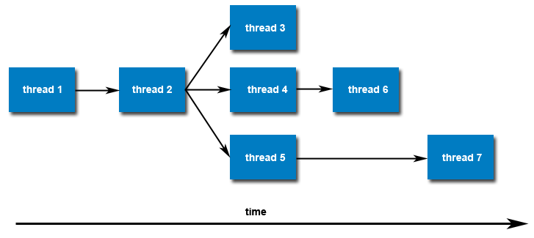
Thread Creation in Practice
Once created, threads are peers, and may create other threads
There is no implied hierarchy or dependency between threads
All threads are equal!

Slide 35
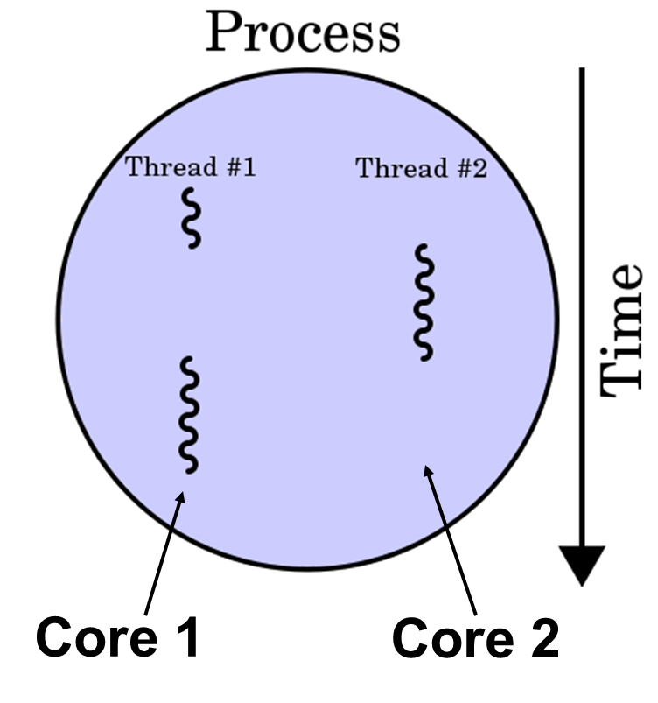
Thread Concurrency
With a single core CPU: Time Sharing
Multi core CPU: true concurrency
When one thread is waiting for an IO to complete…
… another thread can use the CPU for some computing
At any one point in time, CPU is used by only ONE thread
Threads can execute in parallel, one on each core.

Slide 36
Thread Syntax : Thread Termination
void pthread_exit(void* status)
Call pthread_exit()
The function always succeeds and does not return
Status can be obtained by other threads
Similar to process termination
main() returns, or exit() called by any thread

Slide 37

Thread Syntax : Waiting for Threads
int pthread_join(pthread_t tid, void** status)
Equivalent of waitpid()for processes
Wait for a thread to complete
Blocks the calling thread until thread tid terminates
Can obtain the exit status of the thread
Pass NULL to ignore the return value.

Slide 38
How to return data from threads
In our first example of using threads, we showed how threads can be used in place of pipes.
We did not have to return any data from the threads because the sorting is done in place on the array.
What happens if we want the method called by the thread to return values? And what happens if the method needs to take in multiple values?
Recall: For threading the only thing that a function can take as input and give as output is a void* pointer.

Slide 39

When you want to return multiple things with threads C starts to get ugly…
Threading in C when you only need to return a void*:
Threading in C when you want to return multiple things:

Slide 40
Threading Return Example
Objective of the code: Launch multiple threads.
Each thread should have a message that is printed to the main.
Each thread should have an associated message length that should also be printed.
How can we accomplish this when a printing function we create can only take a void* pointer as input?
Answer: Point to a struct

Slide 41
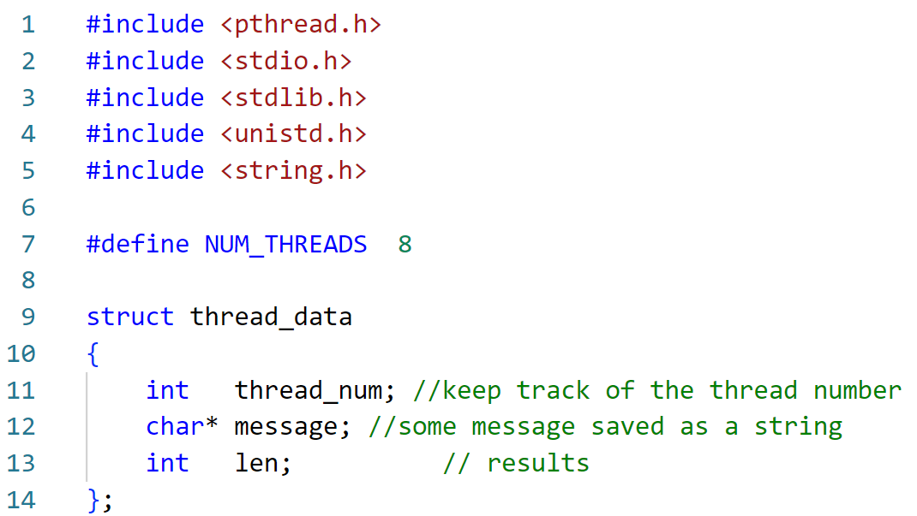
Threading Return Example: The Structure
Create constant value for the number of threads to be used in our code.

Slide 42
Threading Return Example: The Structure
Structure for storing the number of threads, message and length.

Slide 43
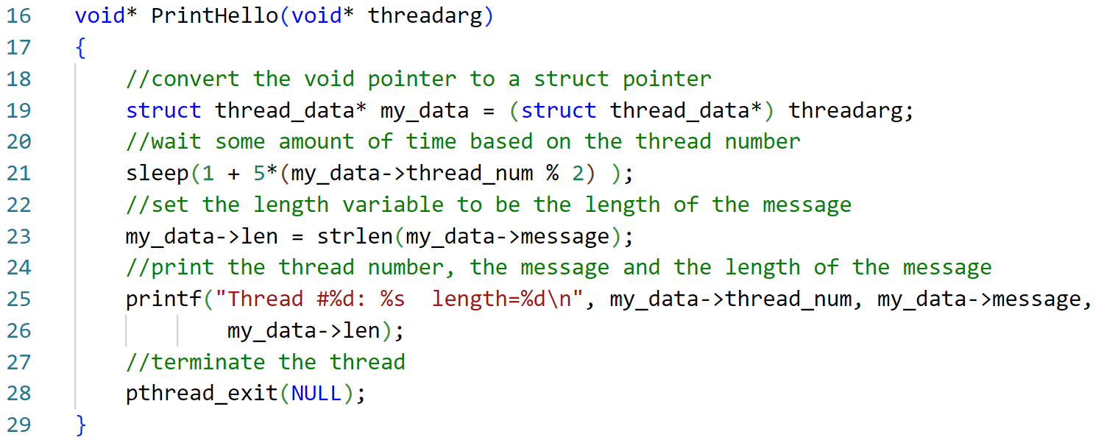
Threading Return Example: The Function for Thread

Slide 44
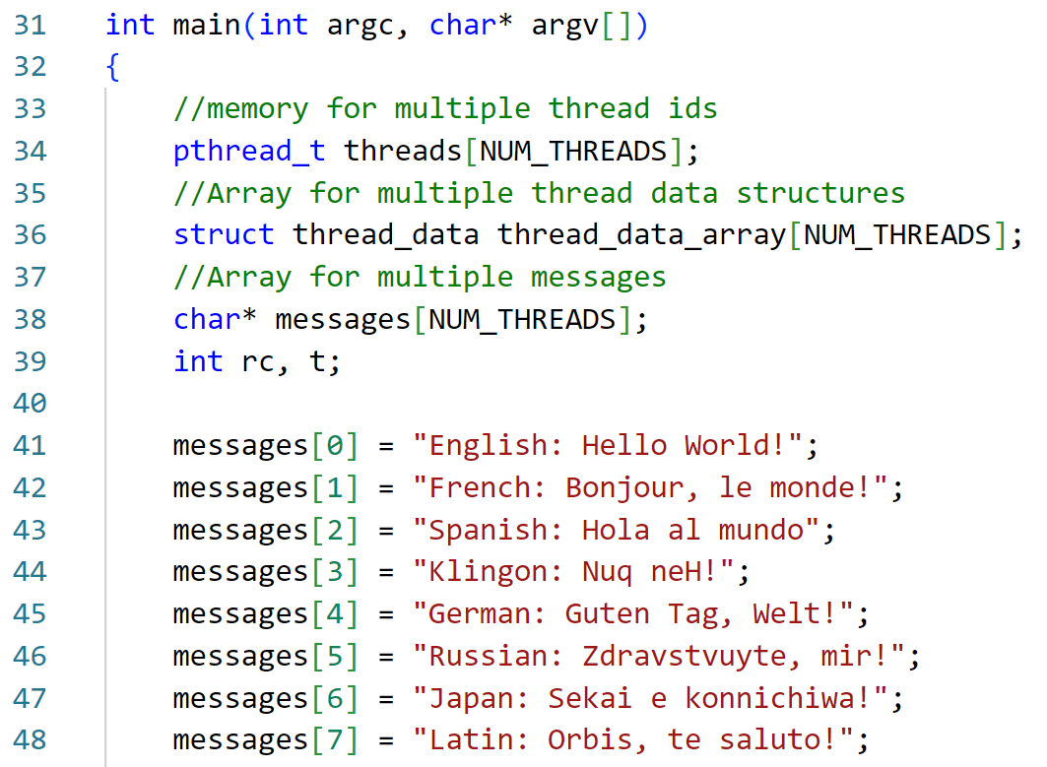
Threading Return Example: Main

Slide 45
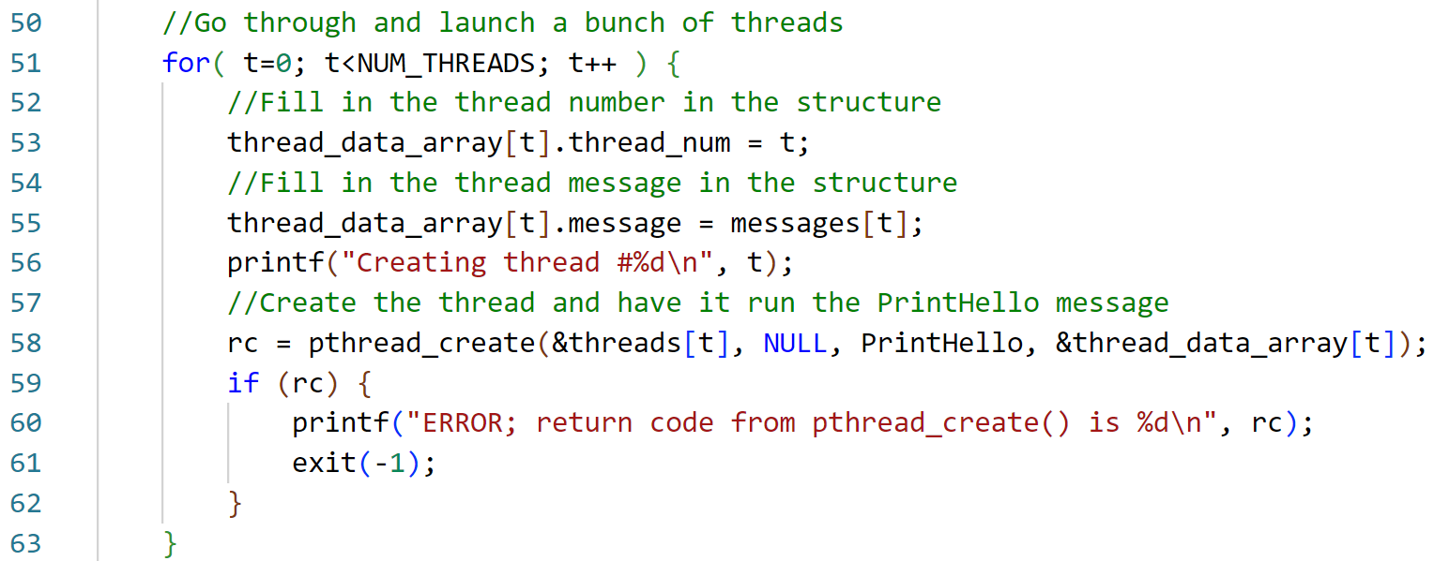
Threading Return Example: Main – Launch the threads!

Slide 46
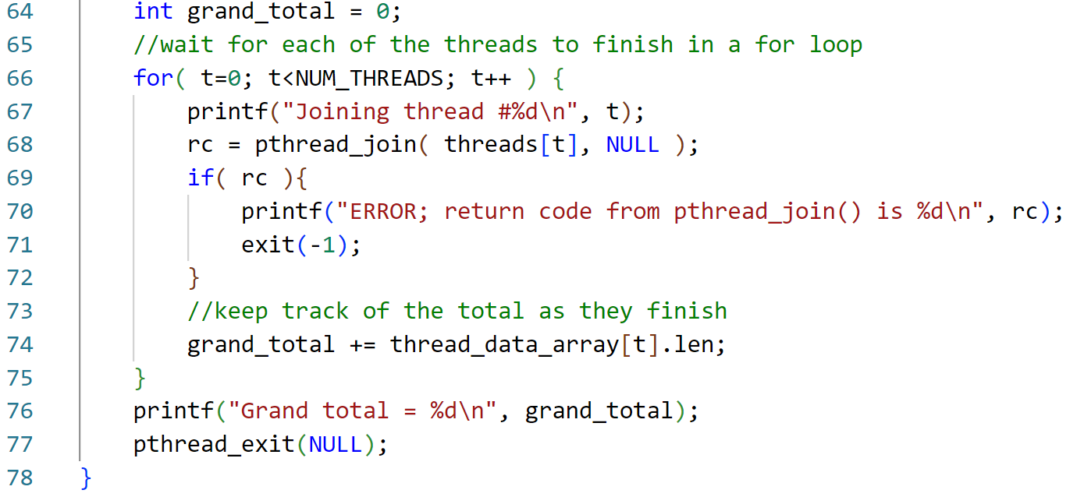
Threading Return Example: Main –Wait

Slide 47
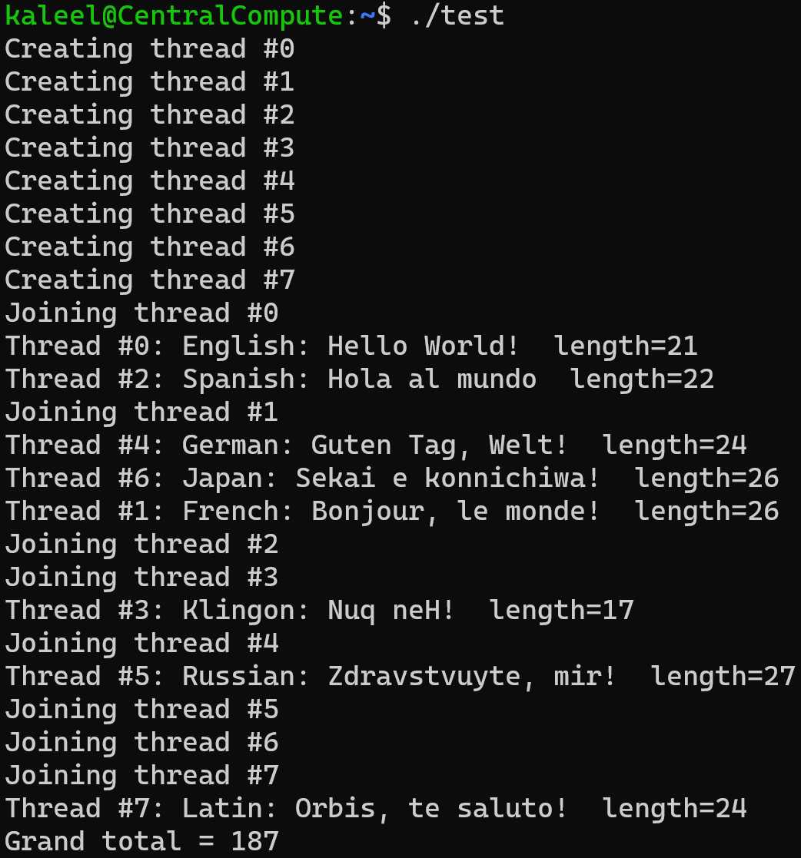
Threading Return Example: Run 1

Slide 48
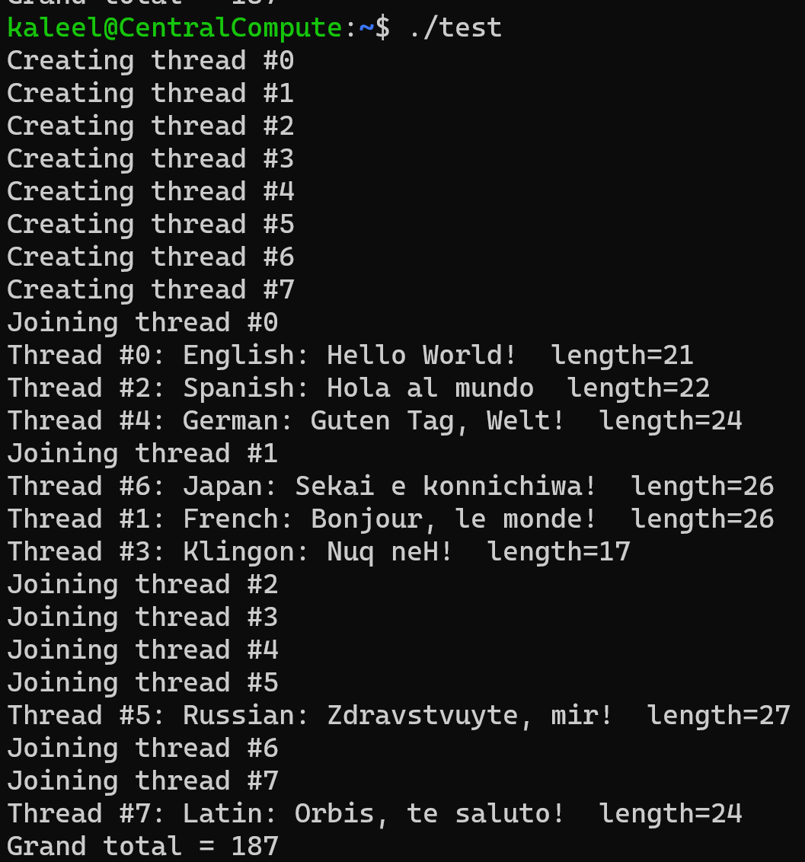
Threading Return Example: Run 2

Slide 49
Notice: when we run the program we get a slightly different output order each time. Why?
The OS is in charge of scheduling. If a thread computation time is high, OS may start working on another thread (time sharing).

Slide 50

Threading Summary
When you have tasks that manipulate the same memory and you don’t want independent copies: use threading.
Threads SHARE memory.
In C functions need to take in a void* pointer and return a void* or just void to be able to be called by threads.
Like fork(), you cannot predict which threads finish first.

Slide 51
Figure Sources
https://images.ctfassets.net/7ybtdzdgha5d/63nP0ICxcg6QawQlEvAI4v/86d6ff7a7b6c04be4283e18327107e90/cat_string.jpg?w=599&h=599&fl=progressive&q=65&fm=jpg
https://i.kym-cdn.com/photos/images/original/002/428/544/36d.jpg
https://www.clipartmax.com/png/middle/210-2104021_mario-pipe-pixel-mario-tube-png.png
http://davewakeman.com/2016/08/what-is-your-mission/
https://ae01.alicdn.com/kf/Hf8b039a2df9147949691060b40216987N.jpg
https://s.yimg.com/ny/api/res/1.2/x55HCa5o.sabbyJ.sKSdsg--/YXBwaWQ9aGlnaGxhbmRlcjt3PTY0MDtoPTY1Ng--/https://media.zenfs.com/en-US/homerun/the_mighty_beauty_225/20754226766e0c2e9fde06c0b9d70557
https://i.imgflip.com/42yc1h.jpg?a466320

Slide 52
Slides to review on your own

Slide 53
Reading
Book “Programming With POSIX Threads”
Chapters 1, 2, 3, 4
Chapter 5, Sections 1 – 4
Nice to read too
Chapter 6, Sections 1 – 5
Chapter 8 [debugging]
Chapter 9 [reference]

Slide 54
The Pthreads API naming convention
Routine Prefix | Function
pthread_ | General pthread
pthread_attr_ | Thread attributes
pthread_mutex_ | mutex
pthread_mutexattr | Mutex attributes
pthread_cond_ | Condition variables
pthread_condattr | Conditional variable attributes
pthread_key_ | Thread specific data keys

Slide 55
Applications of threads
Parallel computing
On multi-core machines, threads can be executed at the same time
Overlap CPU work with I/O
While one thread is waiting for an I/O, others can perform CPU work
Asynchronous event handling
E.g., a web server can both transfer data from previous requests and manage the arrival of new requests
Priority/real-time scheduling
Important tasks can be scheduled with higher priority
Computer games
Each thread controls the movement of an object
…

